Slide 1



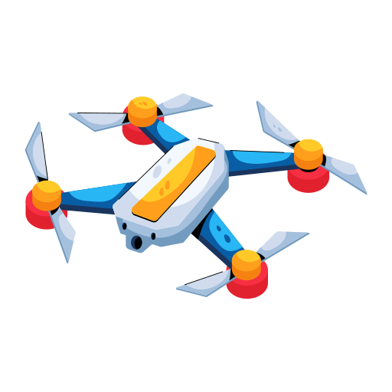
OUR
DRONE
Presented By : Prosigner Team

Slide 2


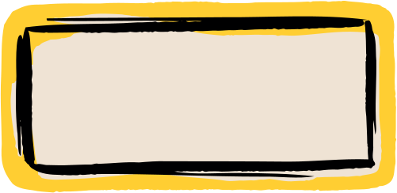
TEAM MEMBERS :
Sara Gad El-karem
Arwa Ahmed Amin
Eman Hammam Ahmed
Menna Tuallah Mohamed Saad
Nermeen Asharaf Abdelwahab
Esraa Nasser Hanafy

Slide 3
OUR WORKFLOW
Modelling
Materials
Imagination
Animation
Rendering

Slide 4


ARE YOU READY ?

Slide 5
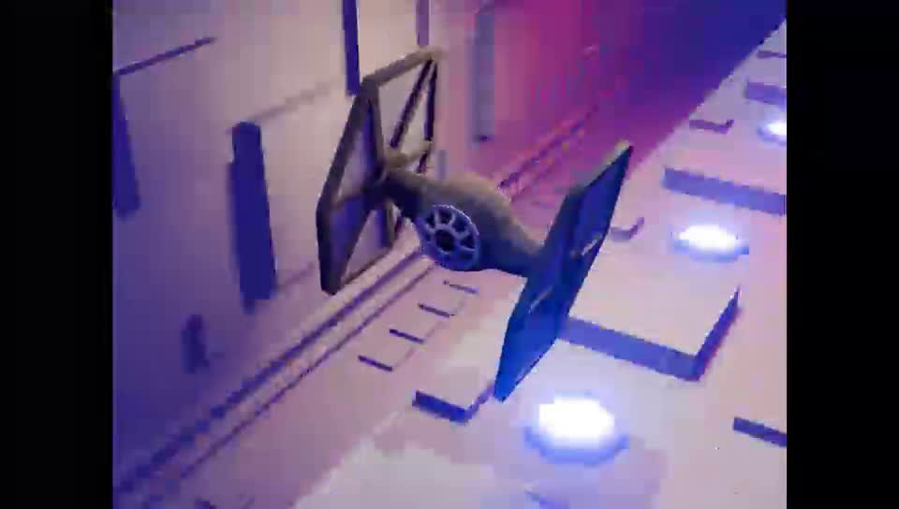

Slide 6

IMAGINATION
REPRESENTATION OF 2D IMAGES
Drone Design
(Drone Movement)
body Design
Drone Colors
Intro Design and Colors

Slide 7
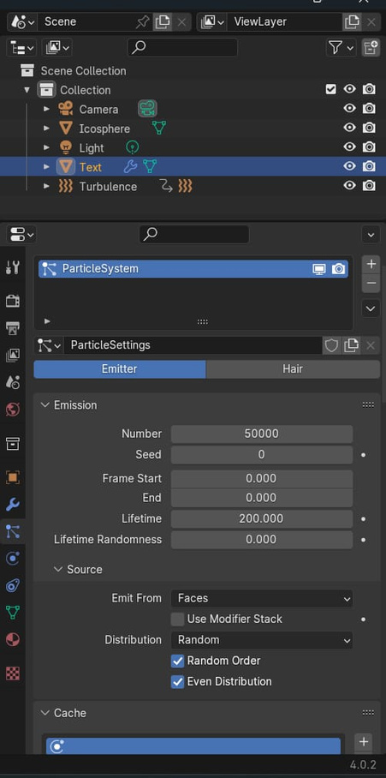
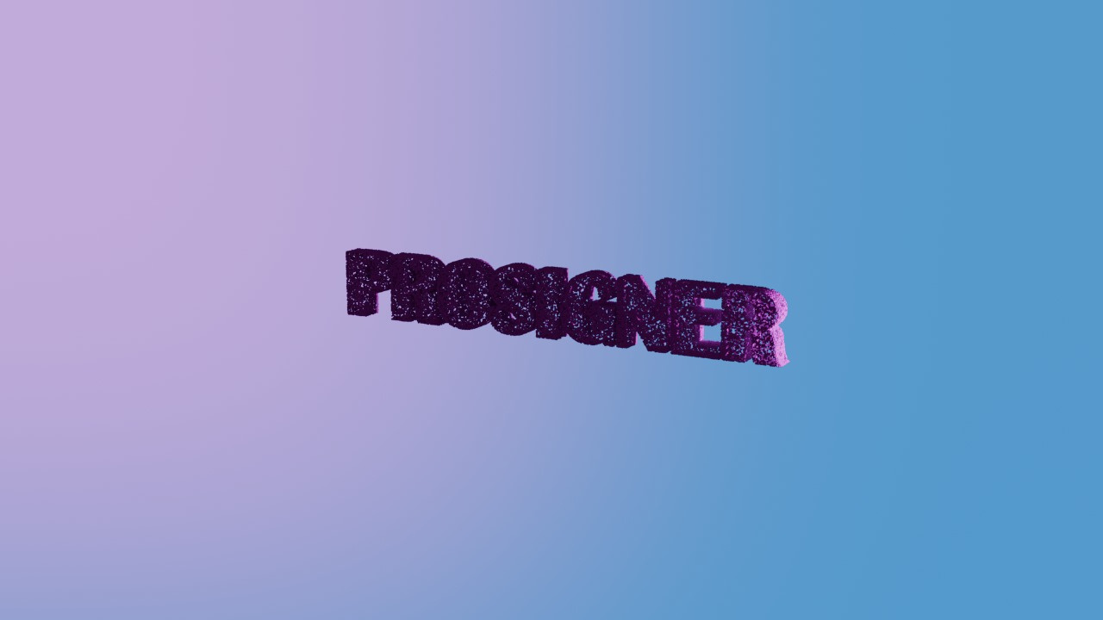
intro explanation

Slide 8
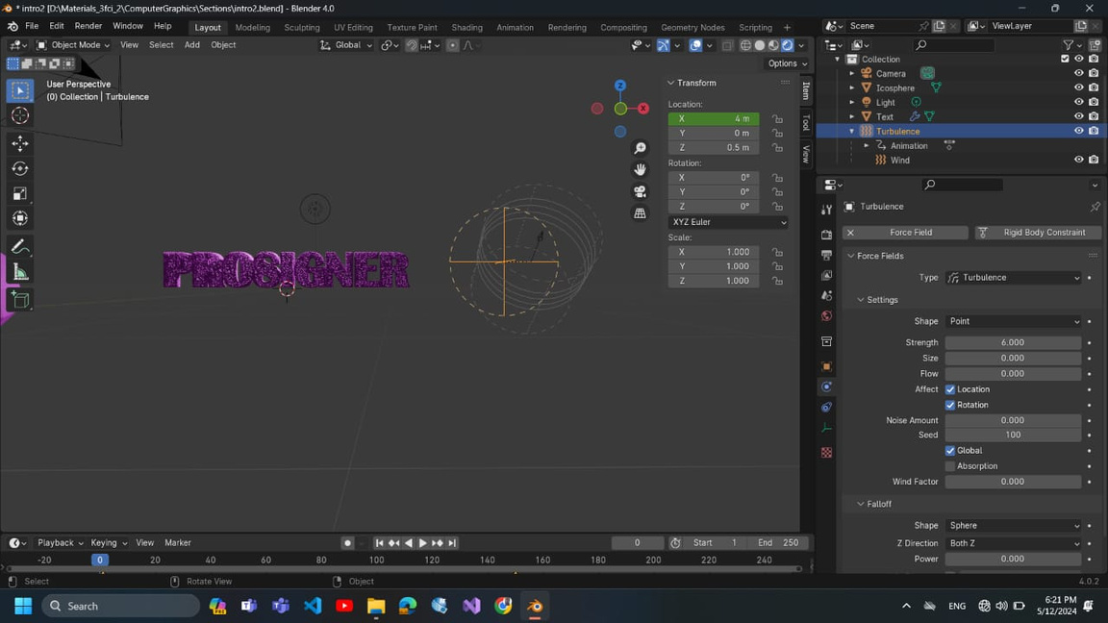
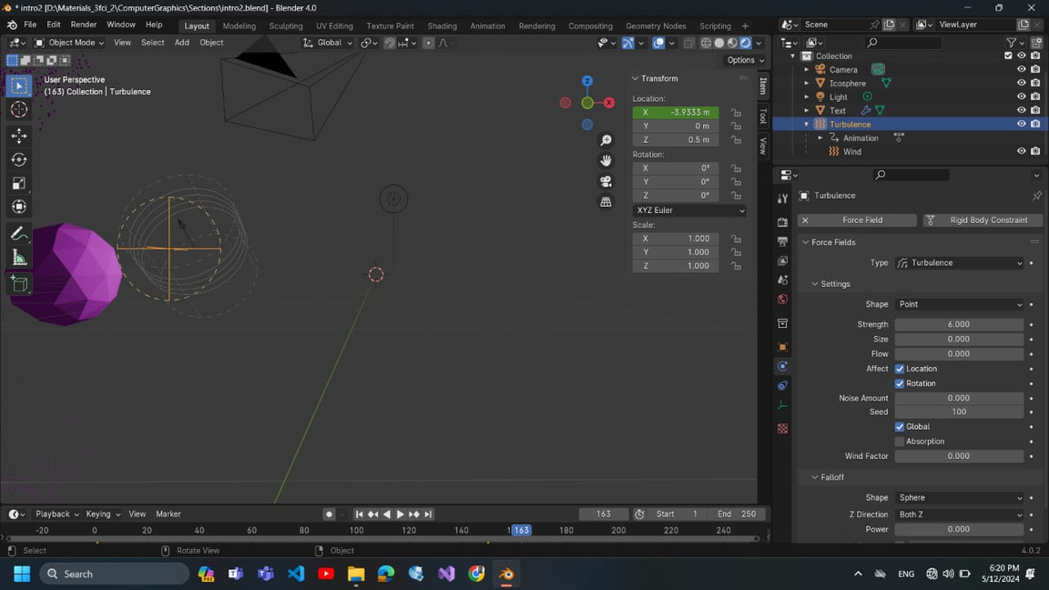

Slide 9
Number of icoshpere

Slide 10

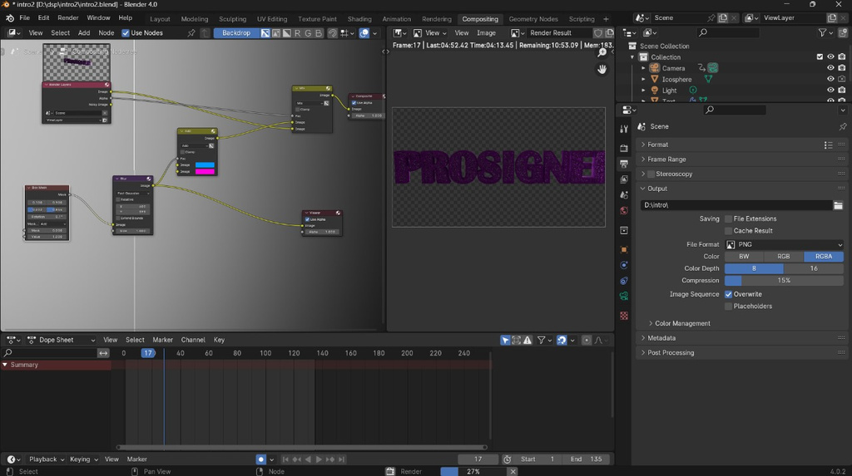
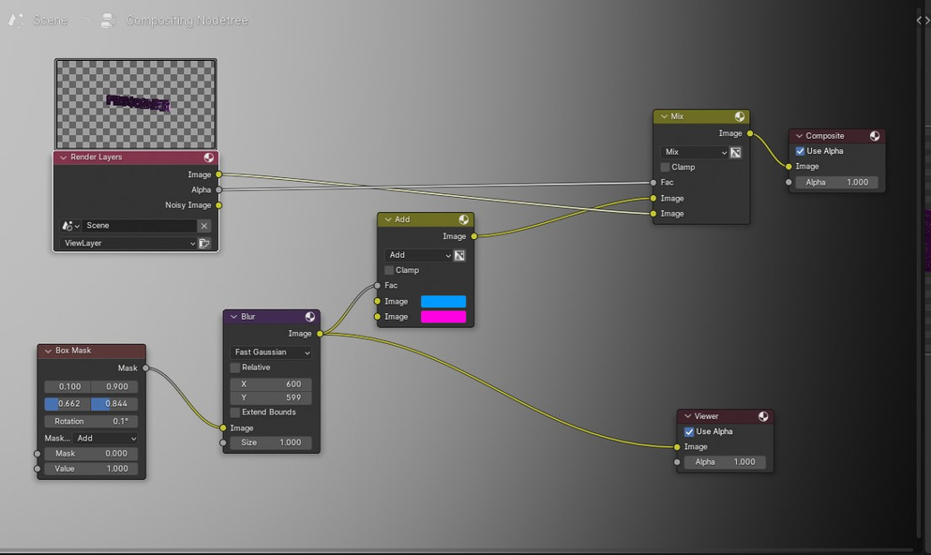
Colors Of the Intro

Slide 11

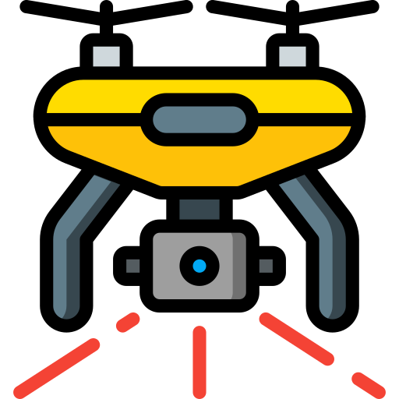
MODELLING
Build the basic structure
Start with Basic Shapes
Creating Main Body of Drone
Create GateWay
Add Details

Slide 12
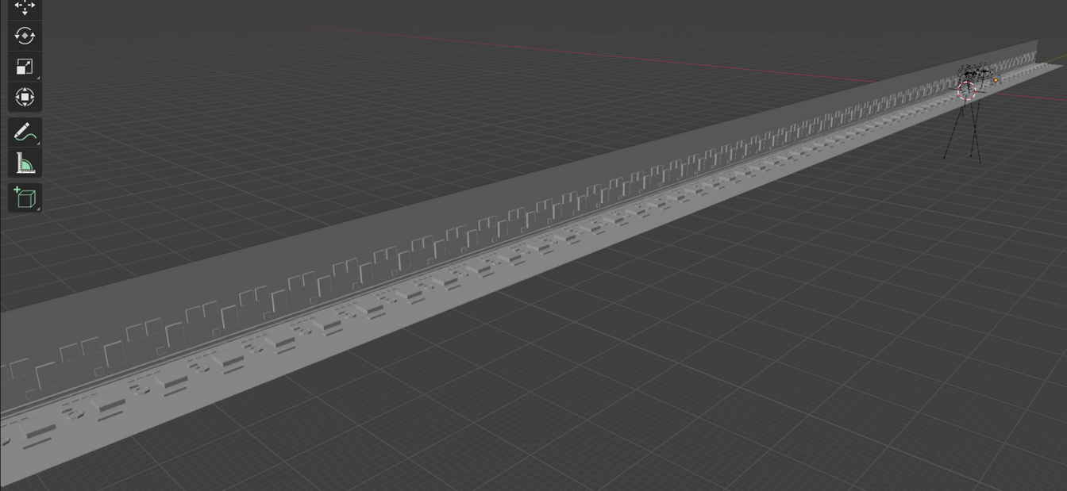
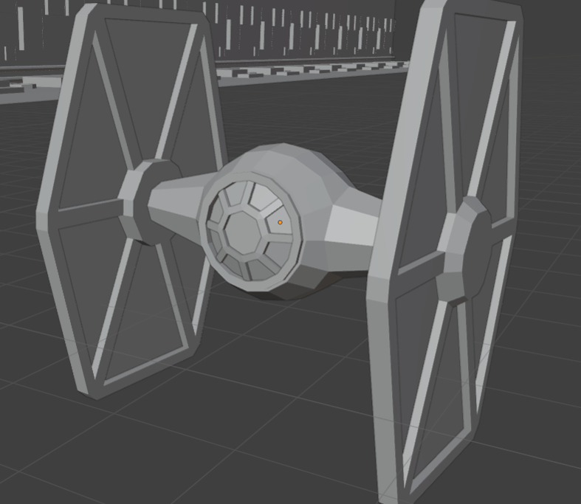

Slide 13
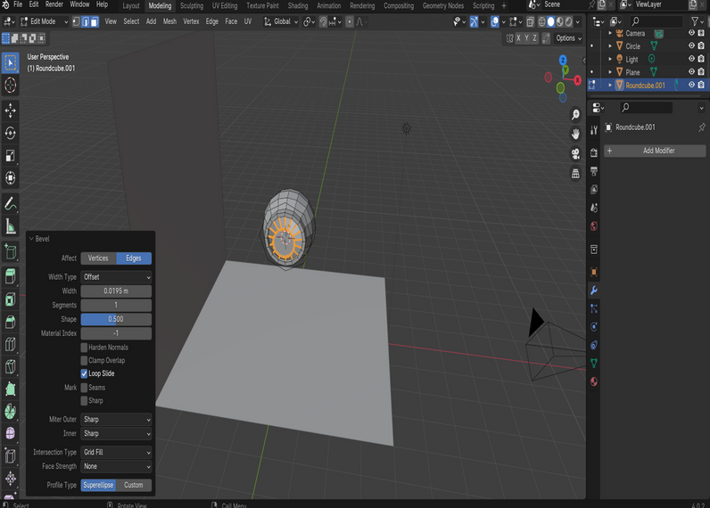
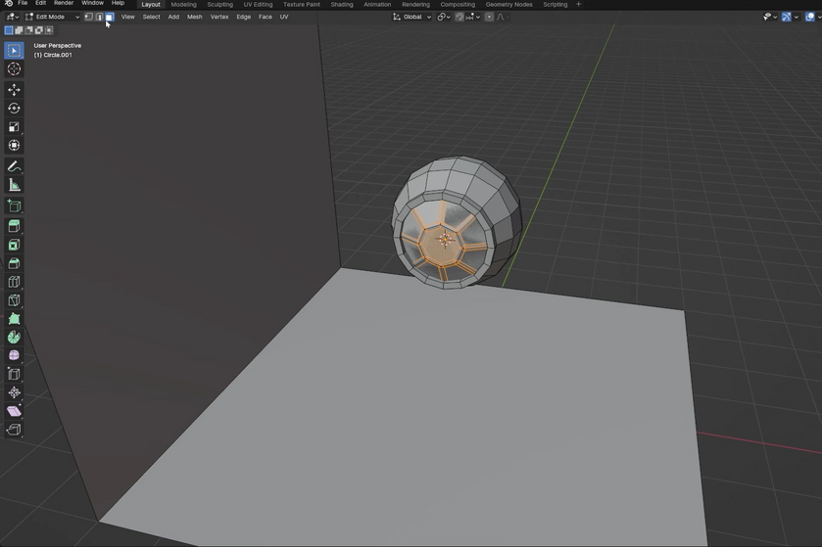
The Main Body
We used the main concepts in it like:
adding new shape(Shift+A )
Controlling subdivision modifier value
Add new extensions from Add-ones(loops_extra Objects)
Scaling(S)
Changing body Position(G)
Rotation(R)
Add Bevels(ctrl+b)
Adding loopcut (ctrl+r)

Slide 14
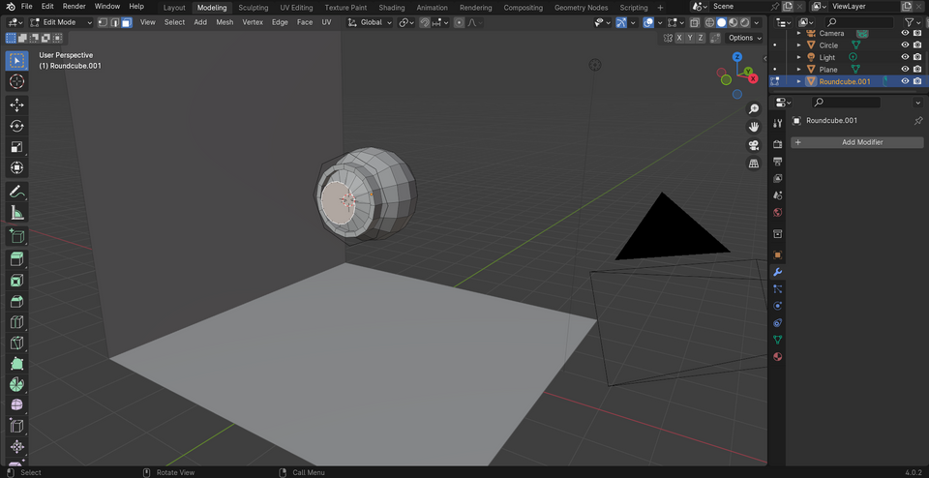
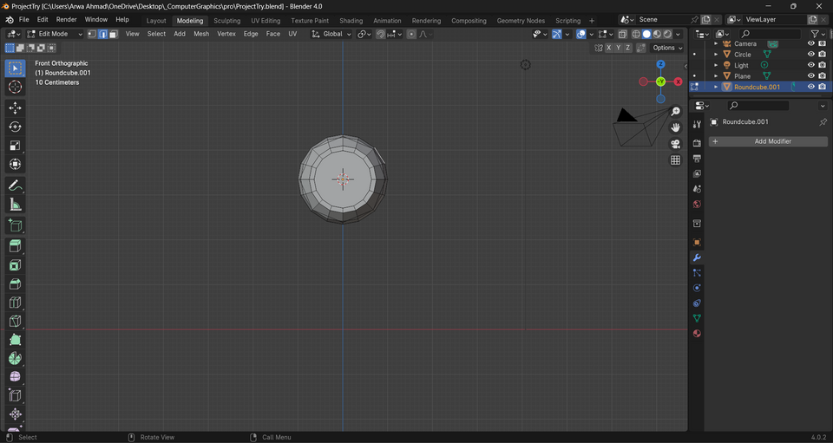
The Main Body
Adding Inset Faces (i)
Extrude process(e)
Box Selection(Shift+b)
Duplicate the object
(Shift+d || Alt+Shist+d(symmetric duplicate)
Centring(Shift+c)
Front view and Right view
Edit mode(vertex_Edge_Face)
Repeat(shift+r)

Slide 15
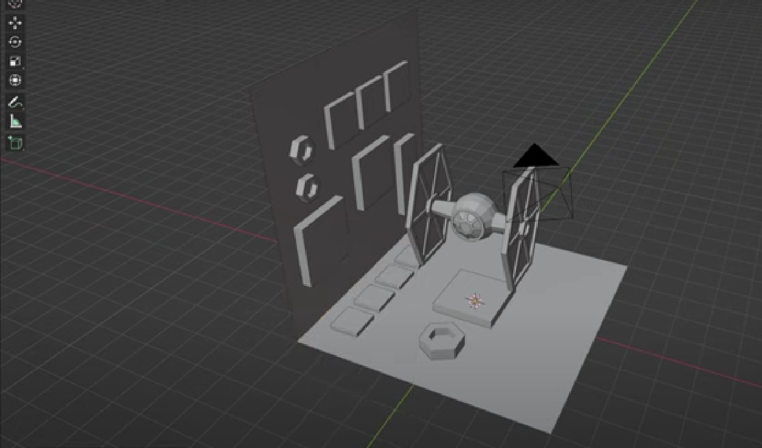
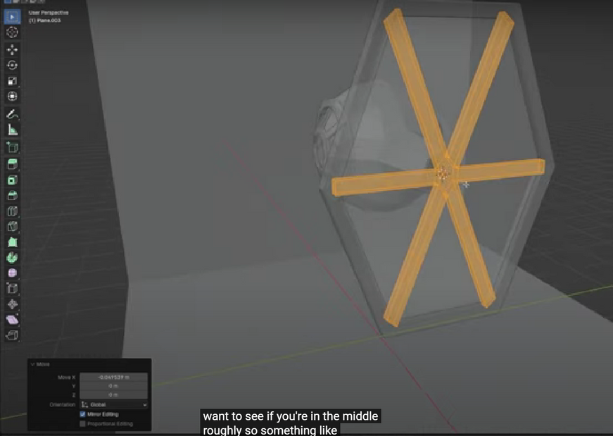
Scaling(S)
Adding loopcut (ctrl+r)
Add Bevels(ctrl+b)
inset face(i)
j-join
Extrude process(e)
f-fill
shift s-->cursor to world origin
shift A-plane
extrote
Alt-D
Repeat(shift+r)

Slide 16
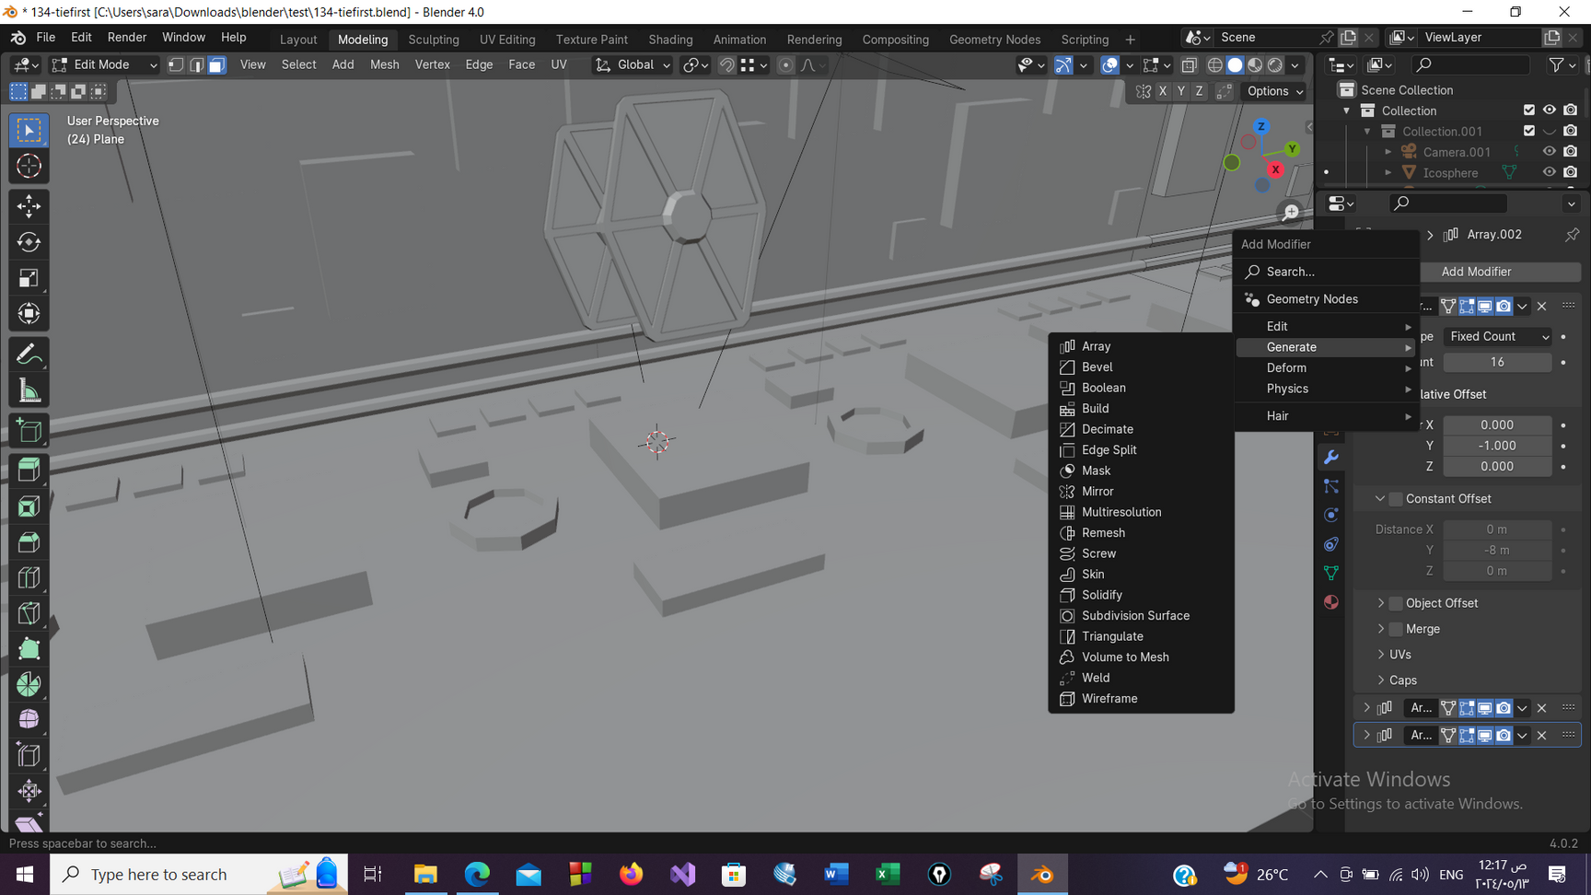
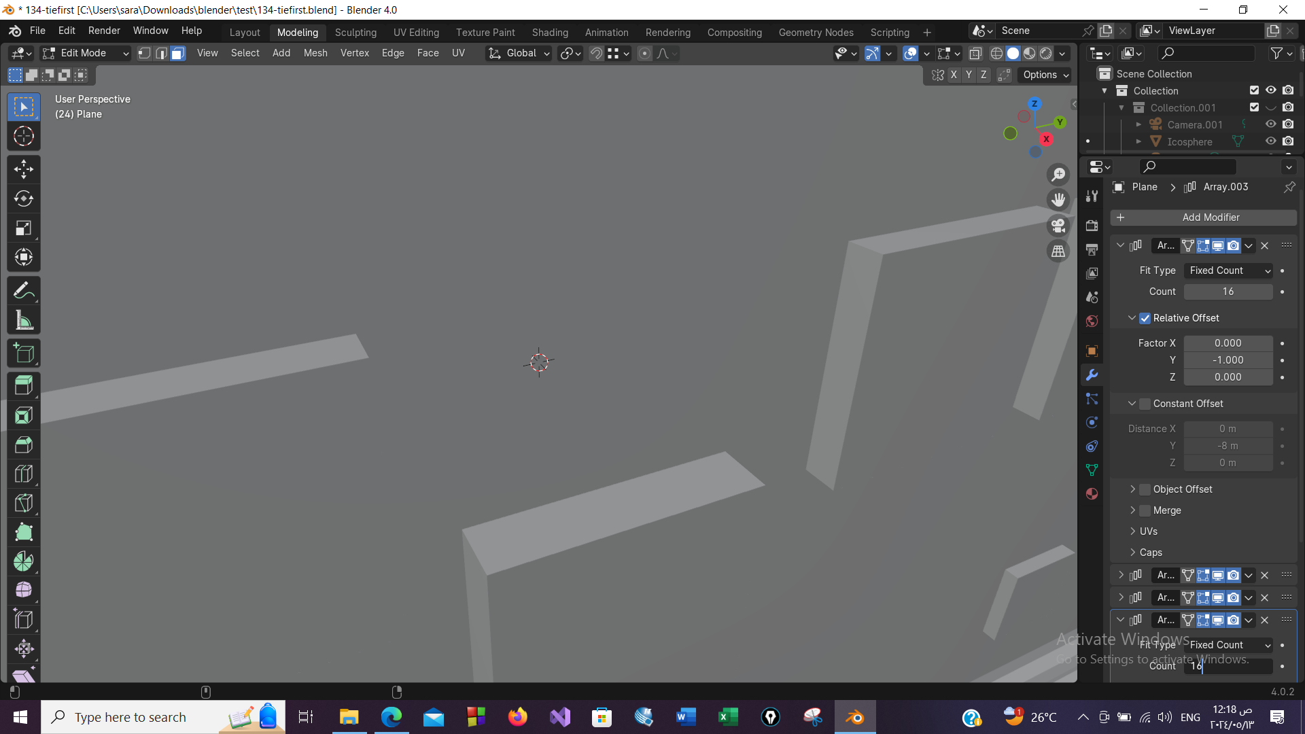

Slide 17

MATERIALS
Surface Properties For Drone And Intro
(color,reflectivity,transparency, roughness)
Materials Creation
Add Lighting

Slide 18
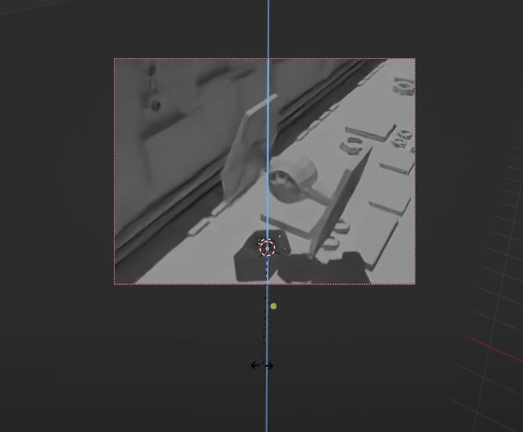
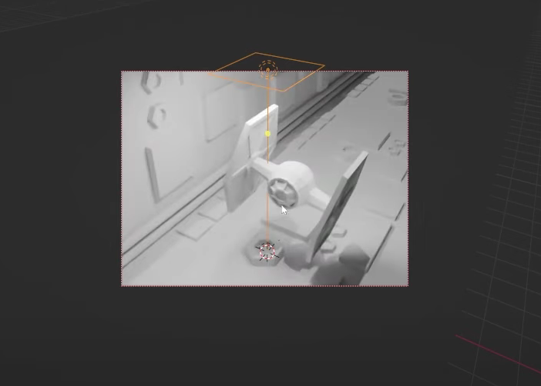
Add Sun Light and Control it (Rotation (R)+ Z )
Add Area Lights

Slide 19
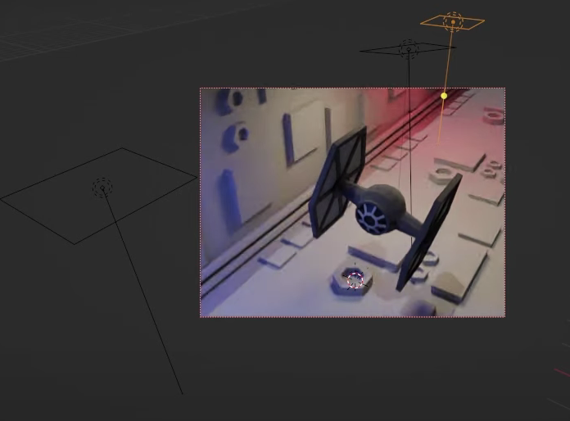
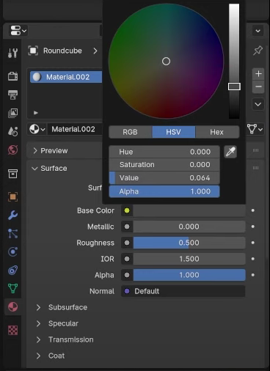
Area Lights + Materials Creation

Slide 20
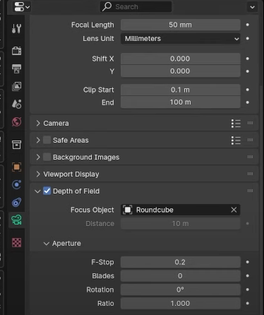
Adjust F-Stop to Get Nice Blur in The Background

Slide 21
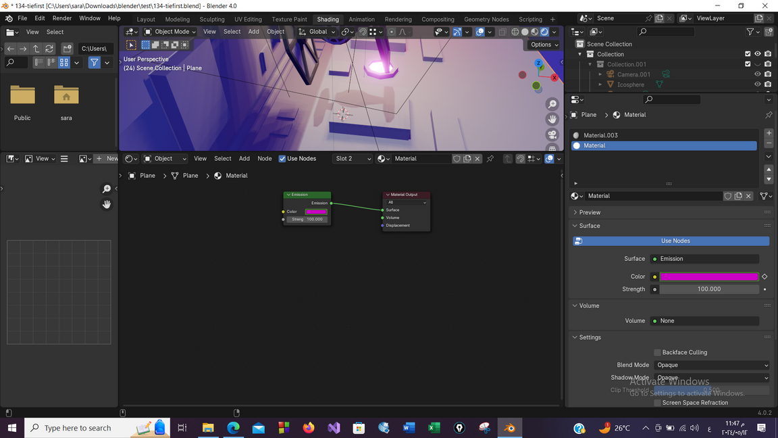
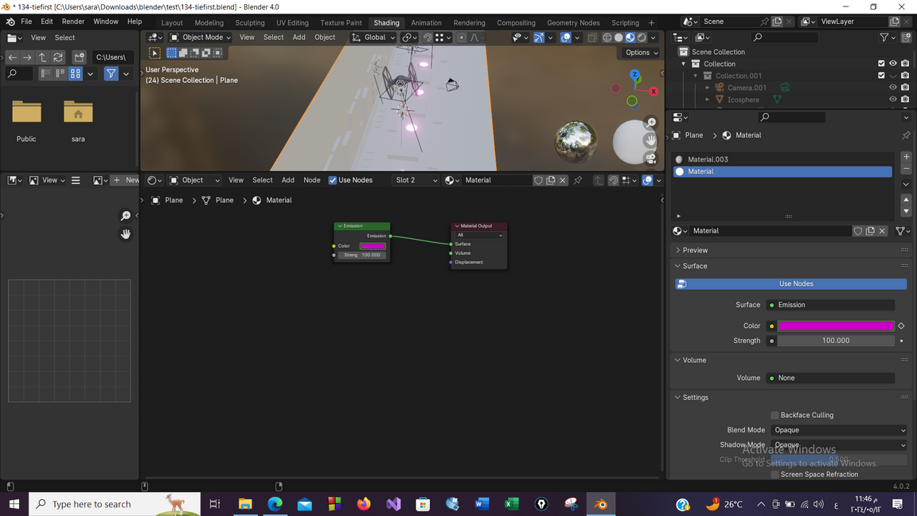
Lights For The Body

Slide 22

ANIMATION
Drone Rotation
Animate the color values of the drone light
Gateway Animation

Slide 23
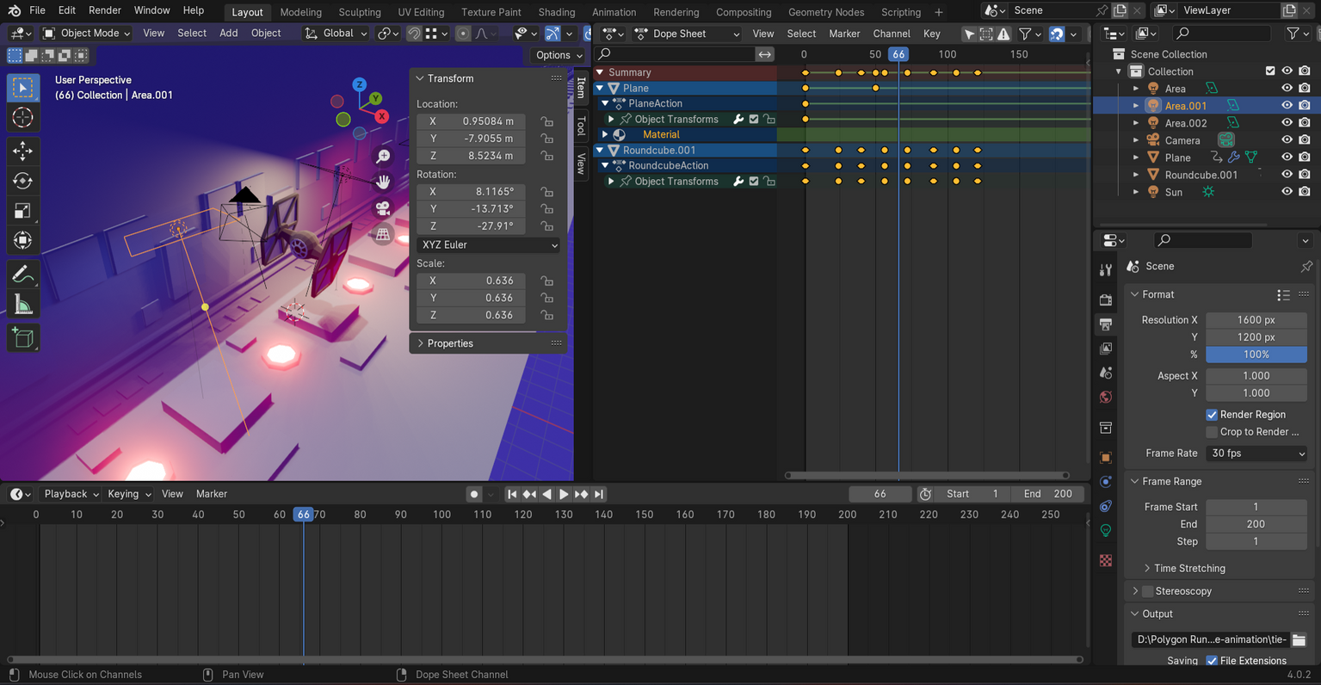
Animation
-Faster Movement
-Body Rotation
-Add Modifier for:
(Noise Modifier)
up and down movement
-Inside and Outside
Rotate

Slide 24

RENDERING IN BLENDER IS THE PROCESS OF GENERATING A FINAL IMAGE OR ANIMATION FROM A 3D SCENE.
It involves calculating the lighting, shading, and textures of objects in a scene to create a realistic visual representation.
Blender uses a rendering engine to process the 3D data and produce the final output.
The rendering process in Blender can be adjusted and customized to achieve different visual effects.
Rendering in Blender is essential for creating high-quality images and animations in the software.
RENDERING

Slide 25

THANK YOU

